Slide 1
















Unary
Code
  Adisti Nastiti (211344001)
  Dyelvio Wijaya (211344012)
  Rezan Candrawinata (211344025)
23:11

Slide 2
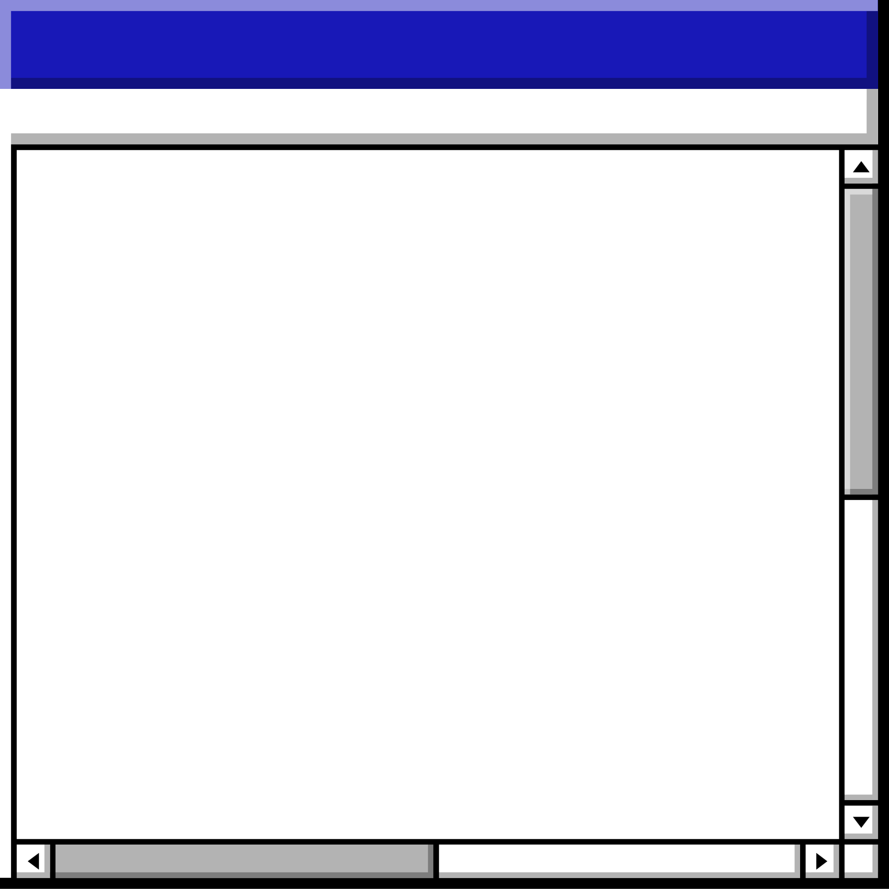

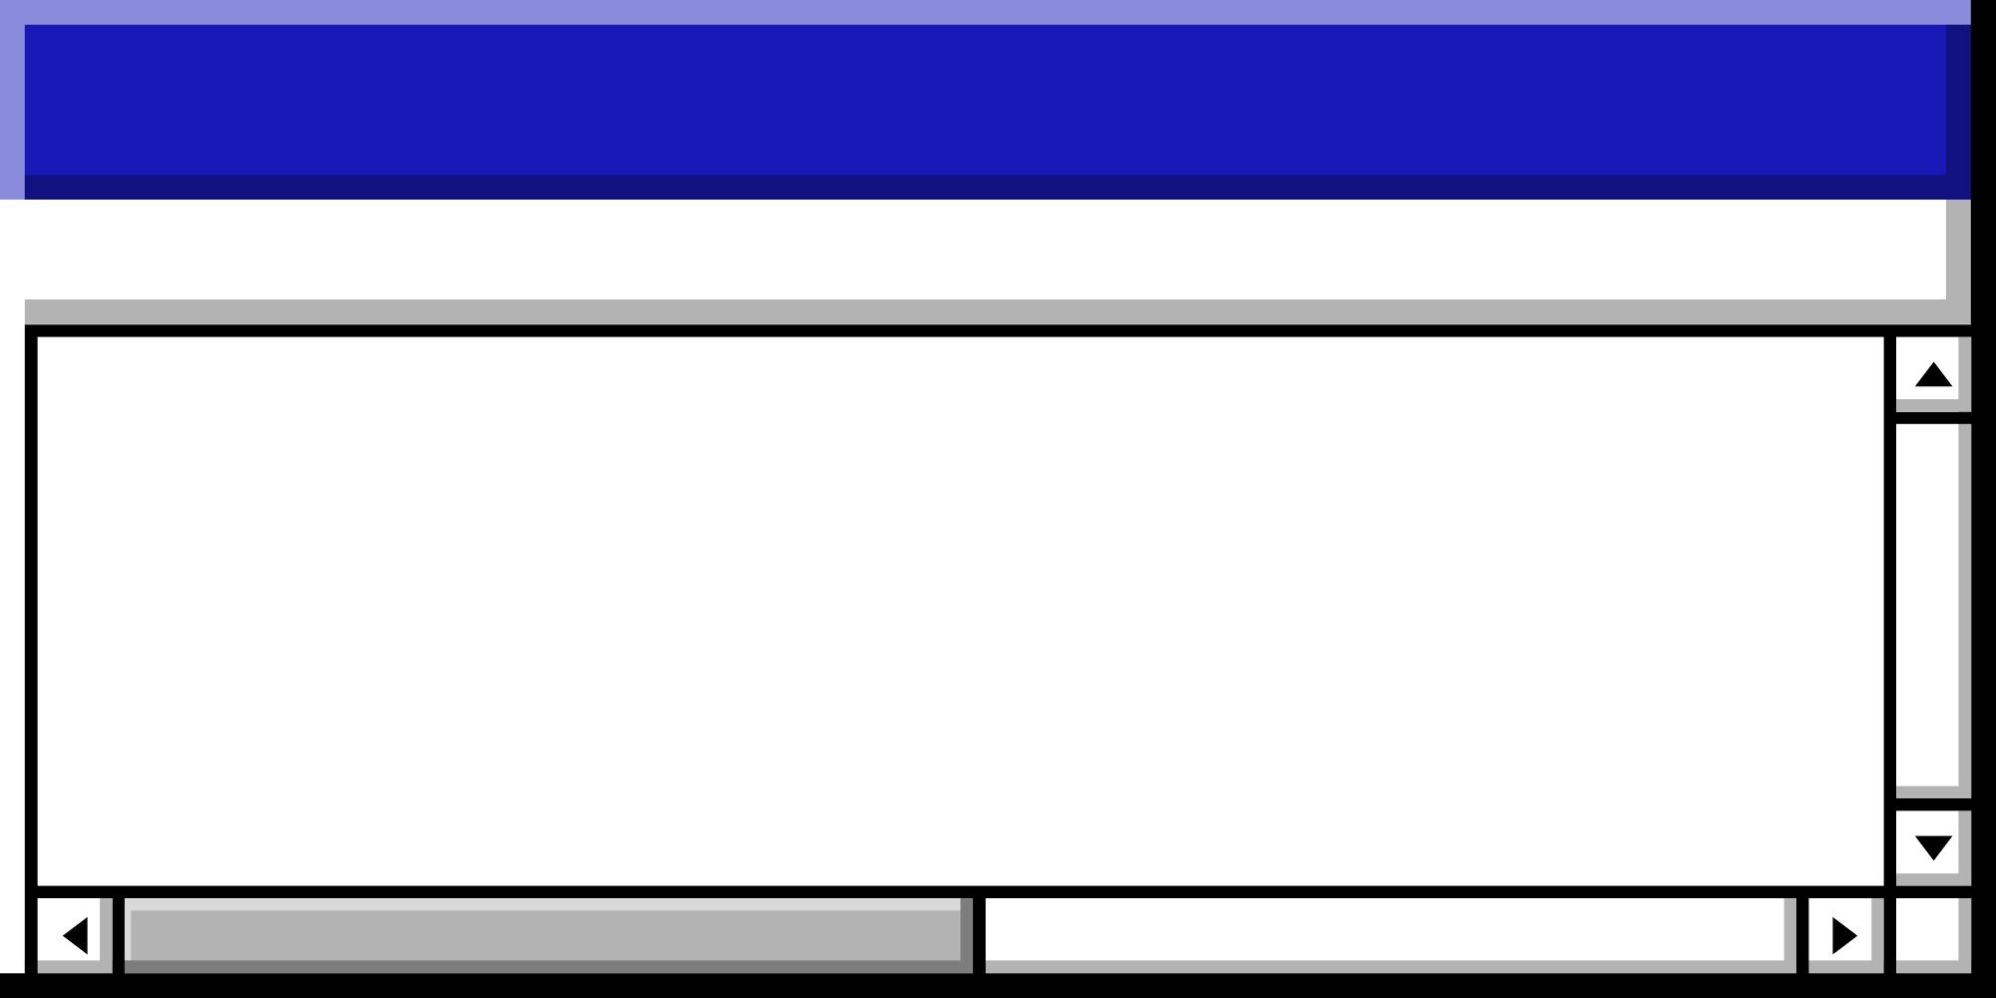


Topic
Background
Applications
contents
Encoding
Decoding
General
Unary
Code

Slide 3
Background
Unary is the simplest way to represent numbers. It has been used since ancient times and is still used today.

Slide 4
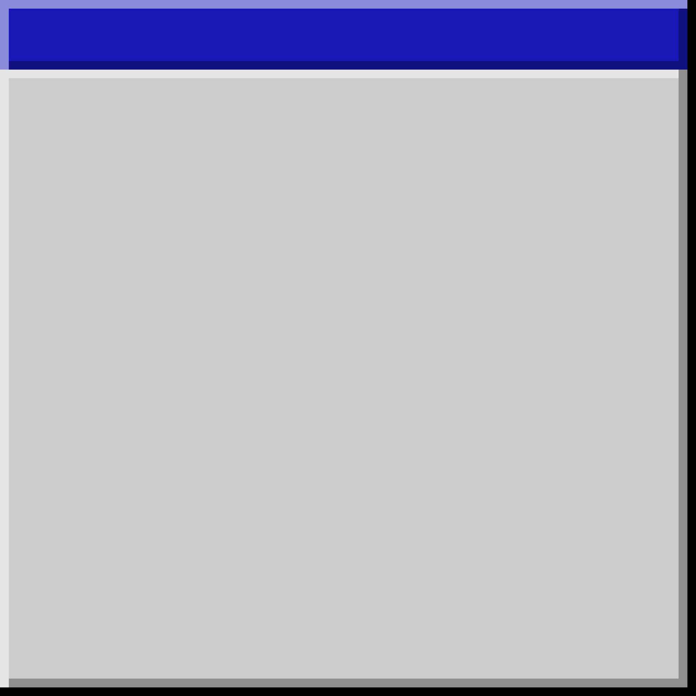
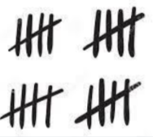
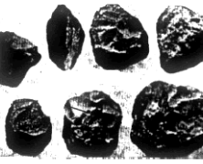
Long History
Contemporary Use
Unary code, or the unary numeral system, has a very long history and has been used by various ancient civilizations. Examples include the use of stone markings, tally marks, or cuneiform symbols to count and represent numbers.
While unary code is not used in practical applications to represent numbers in everyday life or modern computing, its basic form is still used in some cases. For example, in some programming languages or very basic computing systems, unary code may be used for simple testing or counting functions.

Slide 5
Applications
Unary code is a very basic and inefficient encoding method for representing numbers. While it is not typically used in practical applications due to its lack of efficiency, it does have some theoretical and educational uses.

Slide 6
Theoretical Understanding
Counting and Algorithms
Error Detection
Unary code is often used in theoretical computer science and information theory to illustrate concepts related to encoding, decoding, and counting. It serves as a simple example to explain the fundamental principles of numeral systems.
Unary code can be used in teaching algorithms and data structures, especially when explaining concepts like counting, iteration, and loops. It is useful to illustrate basic algorithms and processes.
In some error detection and correction algorithms, unary code can be used as a basis for comparison to demonstrate the inefficiency of certain encoding methods.

Slide 7
Unary code is not a suitable method for data compression; instead, it often results in data expansion. The fundamental idea behind unary code is to represent numbers using a sequence of symbols, typically '1' and '0' for positive integers. Unary code uses a fixed-length representation for each number, where the number itself determines the length of the representation.
Unary Code is not a Data Compression
Data compression, on the other hand, aims to represent data in a more efficient manner, typically by reducing the number of bits needed to store or transmit information. Unary code doesn't achieve compression because it adds more bits as the numbers get larger, making the representation longer and less efficient.

Slide 8










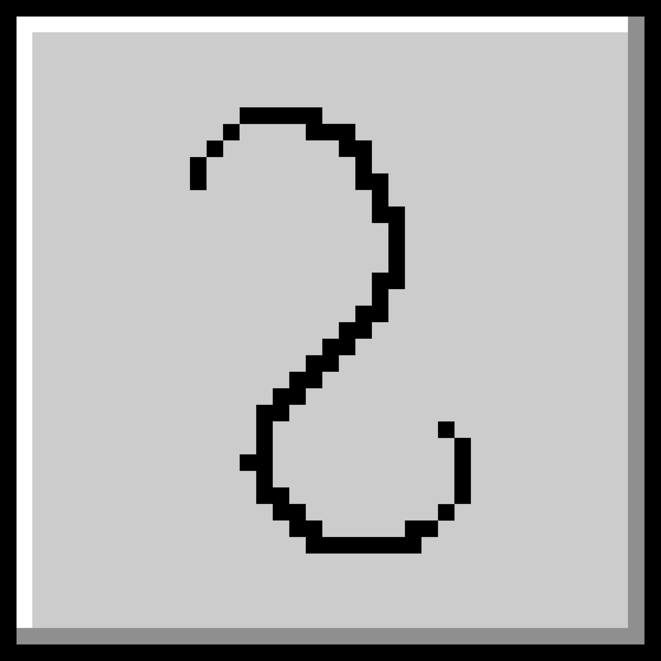




Let's Get Started with Unary Code!
Unary
Code

Slide 9
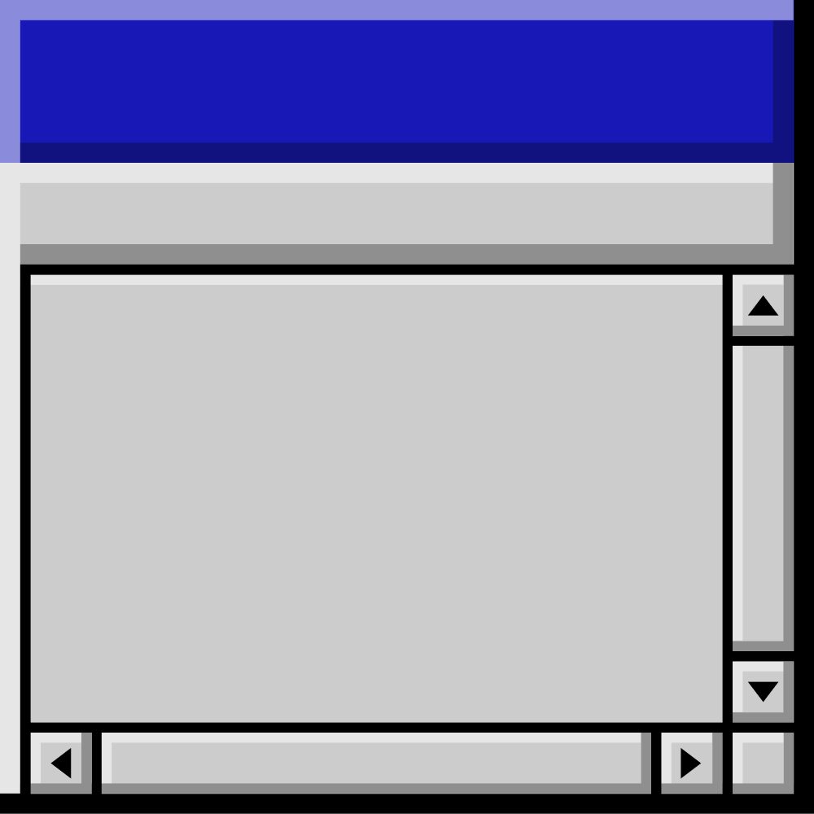
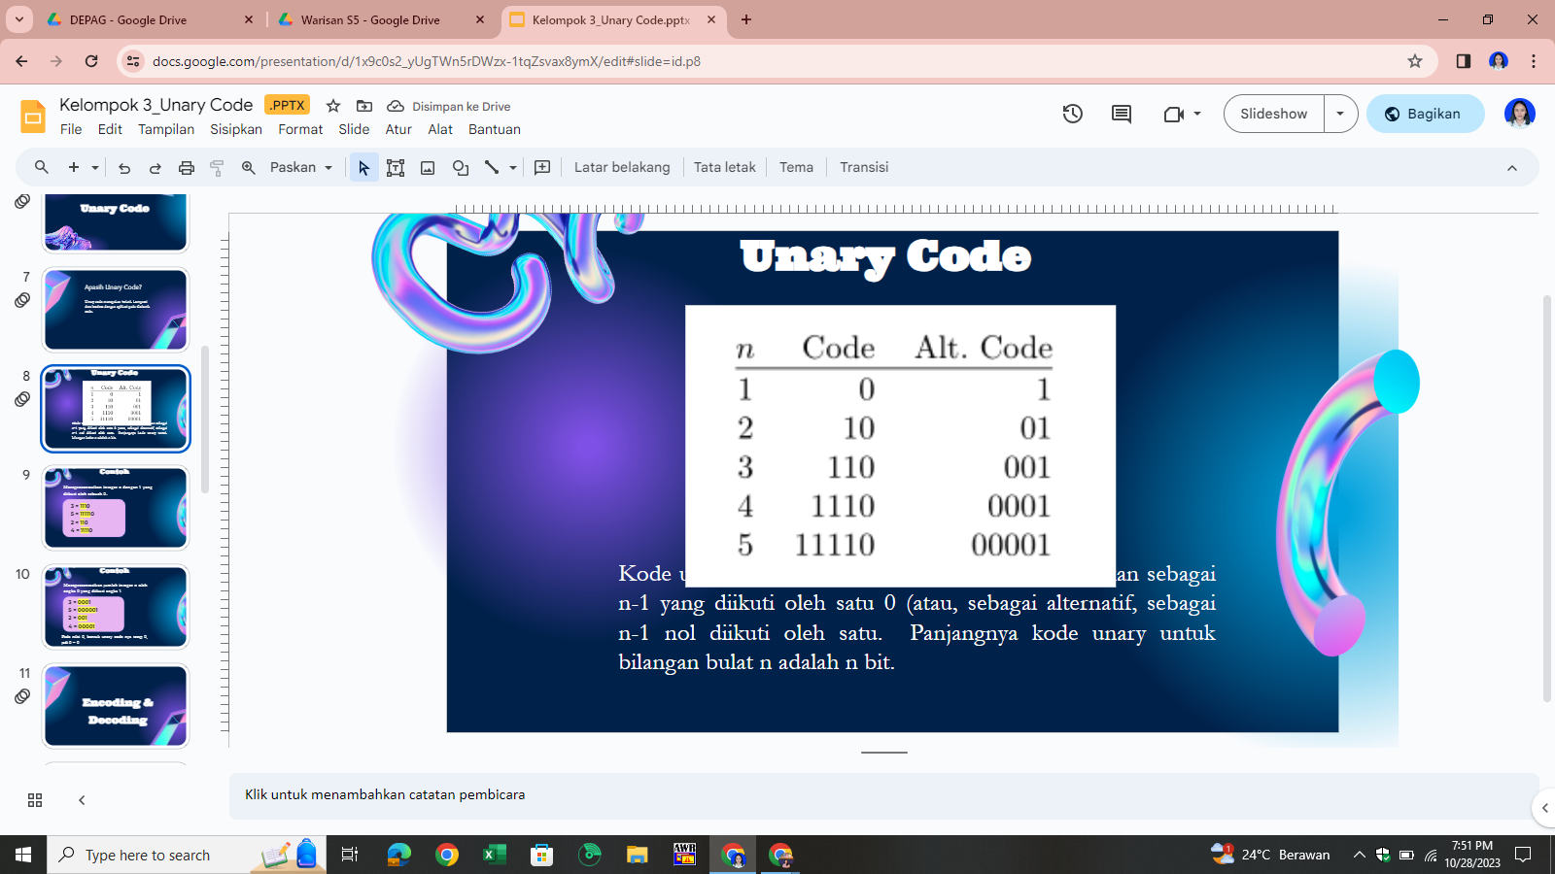
The unary code for a positive integer n is defined as n-1 followed by a single '0' (or alternatively, as n-1 zeros followed by one '1'). The length of the unary code for the integer n is n bits.

Slide 10
Example
Representing an integer n with a '1' followed by a '0'
3 = 1110
5 = 111110
2 = 110
4 = 11110

Slide 11
Example
Representing an integer n with a '0' followed by a '1'
At a value of 0, the unary code form remains 0, so 0 = 0
3 = 0001
5 = 000001
2 = 001
4 = 00001
Ke Halaman Agenda

Slide 12
Time to kick off the fun with Unary Code!
Encoding

Slide 13
Encode
Start with the Number
Determine the Value
Generate Unary Code
Begin with the positive integer you want to encode. Let's say you want to encode the number "3."
The value of the number determines the number of '1's in the unary code. In this case, "3" corresponds to three '1's.
Write the specified number of '1's (in this case, three '1's) followed by a single '0' to represent the end of the number. The unary code for "3" is "1110."

Slide 14
Let's Dive into the World of Unary Code!
Decode
Ke Halaman Agenda

Slide 15
Decode
Start with the Unary Code
Read the Code from Left to Right
Count Consecutive '1's
Stop at the '0'
When you reach a '0,' stop counting, and the counted number of '1's represents the value. In this case, you counted three '1's, so the decoded value is 3.
Begin with the unary code you want to decode. Let's say you have the unary code "1110."
Start from the leftmost digit and move to the right.
Count the consecutive '1's until you encounter a '0.' In this case, you count three '1's.
Ke Halaman Agenda

Slide 16
Buckle up and let's dive into Unary Code!
General Unary
Code
Ke Halaman Agenda
Tajuk Bagian • Tajuk Bagian • Tajuk Bagian • Tajuk Bagian • Tajuk Bagian • Tajuk Bagian • Tajuk Bagian • Tajuk Bagian • Tajuk Bagian

Slide 17
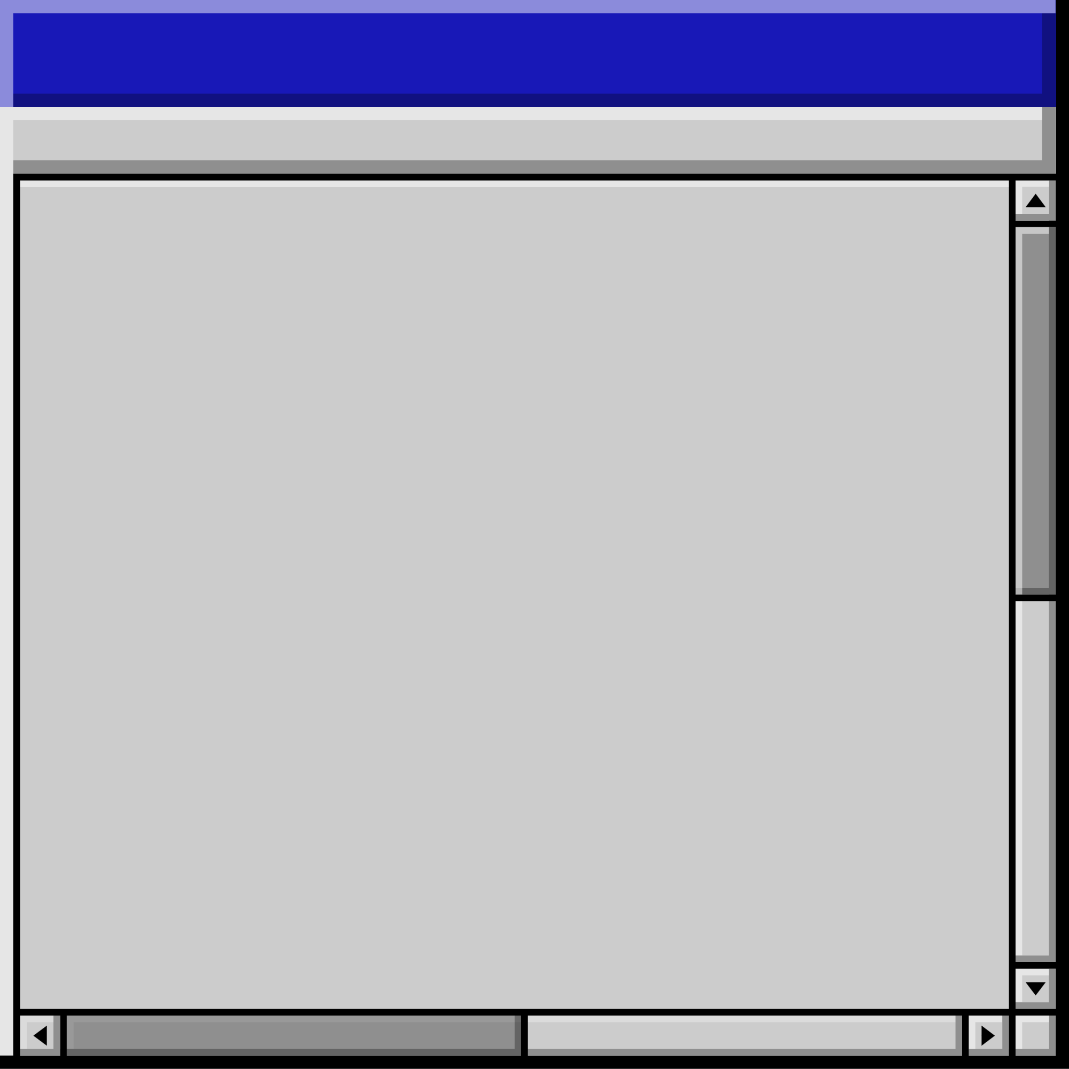
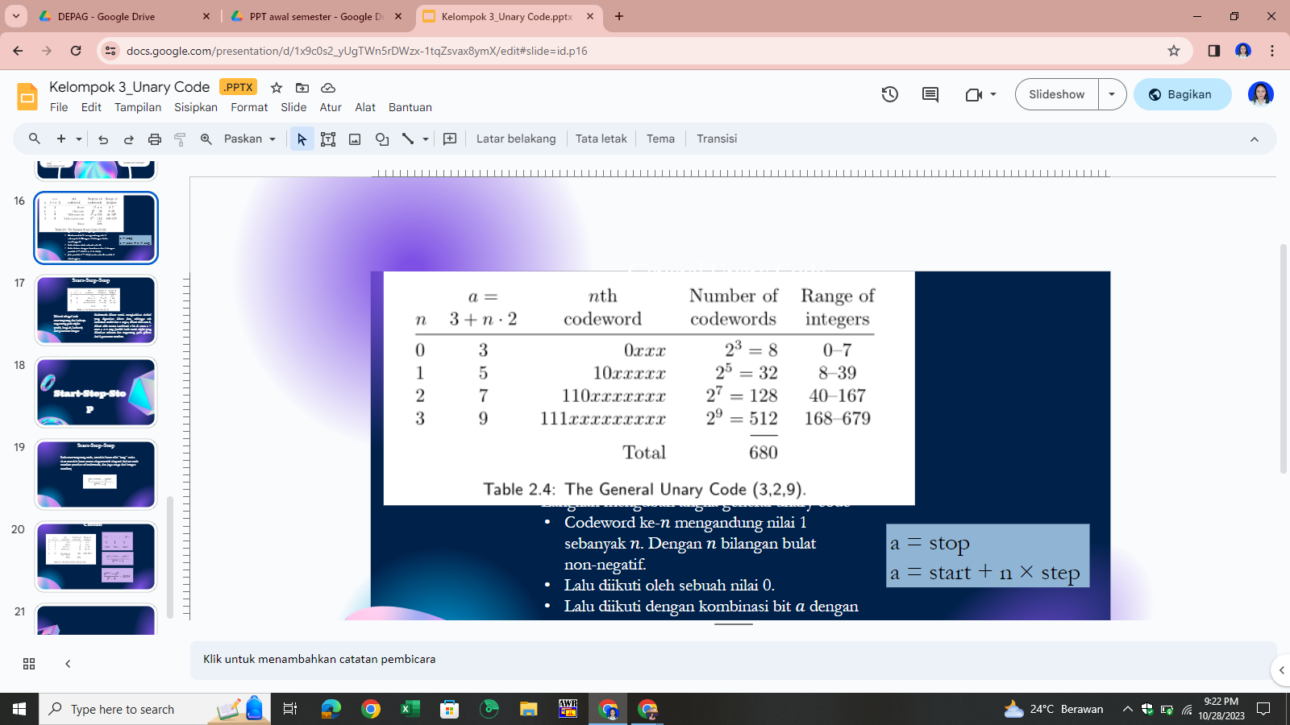
To convert a number into general unary code with the given parameters (start, step, stop), follow these steps:
  Select the Number to Convert: For example, let's convert the number 6.
  Specify the Start Value: The start value is the first number in the range you want to encode. For example, if start = 3, then the start value is 3.
  Specify the Step Value: The step value represents how much each number in the range increments from the previous one. For example, if step = 2, each number in the range will be 2 units apart.
  Specify the Stop Value: The stop value is the last number in the range you want to encode. For example, if stop = 9, then the stop value is 9.

Slide 18
Determine what number will be encoded: for example the number is 6 .
Find out what range the number is in: So if you take the previous example, 6 will be in the range 0 - 7 and 6 will be reduced by 0.
Use the codeword where the number is, and convert to biner for xxx: If you take the previous example again, the binary of 6 is 110, so for the codeword of 6, namely 0xxx, then xxx is entered in the binary of 6. So the result is 0110

Slide 19
THANK YOU
23:11

